Slide 1

Group 4’s Intermediate Work Presentation and Peer Feedback: Mapping Social Determinants of Health in Utah: A Data-driven Approach for Public Health and Clinical Decision-making
Sunho Im • Joshua Kawasaki • Kristin Knippenberg • Mahony Reategui Rivera • L Weaver
GitHub https://github.com/lwynholds/BMI6016_SDOH
Group 4, BMI 6016 Data Wrangling, Spring 2025
Department of Biomedical Informatics
University of Utah School of Medicine
© UNIVERSITY OF UTAH HEALTH
March 14, 2025

Slide 2
BACKGROUND AND MOTIVATION
First conceptualized by the World Health Organization (WHO), Social Determinants of Health (SDOH) have been widely recognized in health research for approximately 25 years
SDOH are “the circumstances in which people are born, grow up, live, work and age, and the systems put in place to deal with illness. These circumstances are in turn shaped by a wider set of forces: economics, social policies, and politics"
In the US, SDOH data are tracked and archived by the Centers for Disease Control and Prevention (CDC), Health and Human Services (HHS), the US Census and their American Community Survey (ACS), the Agency for Health Research and Quality (AHRQ), and the National Institutes of Health (NIH), among others.
In 2018, Cantor et al. published their Factors Affecting Communities and Enabling Targeted Services (FACETS) open-data model
to standardize and compile SDOH-related data at the census-tract level in New York City, and
to integrate community-level determinants with patient health records in clinical settings
We propose to develop a FACETS-based model tailored to the state of Utah, with special focus on air quality as a primary exposure.
By integrating Utah-specific SDOH data, including environmental data, into a framework, we aim to provide a comprehensive tool for assessing community-level health determinants to support informed public health interventions and patient-level clinical decision-making
Group 4, BMI 6016 Data Wrangling, Spring 2025
Department of Biomedical Informatics
University of Utah School of Medicine
© UNIVERSITY OF UTAH HEALTH
March 14, 2025

Slide 3
PROJECT OBJECTIVES
To standardize Utah’s SDOH data at the US census-tract level by integrating multiple sources of publicly available and state-specific data, using:
ACS and US Census Bureau, CDC, Environmental Protection Agency (EPA), and US Department of Agriculture Food Access Research Atlas (USDA) data (data sources from the original FACETS study that are also relevant to Utah)
State datasets from the Utah Department of Health and Human Services
State SDOH variables not otherwise specified that are particular or pertinent to Utah (e.g., urban/rural, electoral participation)
Temporal, categorical, or spatial crosswalks, where necessary
To create a database of census tracts, within which an individual patient’s address can be mapped to a Utah FACETS characterization of SDOH context
To characterize disparities in health outcomes based on the intersection of air quality with other environmental health factors and SDOH.
To give context to any individual patient’s health status and assist patients and providers in deciding how best to improve that patient’s health.
Group 4, BMI 6016 Data Wrangling, Spring 2025
Department of Biomedical Informatics
University of Utah School of Medicine
© UNIVERSITY OF UTAH HEALTH
March 14, 2025

Slide 4






DATASETS
Social Vulnerability Index (2022)
Unemployment • Health insurance status • Housing violations
Behavioral Risk Factor Surveillance System (2022)
Asthma survey • Chronic disease indicators
National Environmental Public Health Tracking Network (2019)
Distance to parks
American Community Survey
Census tract geodata • Urban-rural classification (2020)
Total population • Citizenship • Racial/Ethnic diversity • Education • English proficiency • Poverty • Household income • Respiratory Hazard Index • Gini Index of Inequality (2020)
Access to healthy food (2021)
Crime • Voter turnout (2022)
Walkability score (2020)
Group 4, BMI 6016 Data Wrangling, Spring 2025
Department of Biomedical Informatics
University of Utah School of Medicine
© UNIVERSITY OF UTAH HEALTH
March 14, 2025

Slide 5

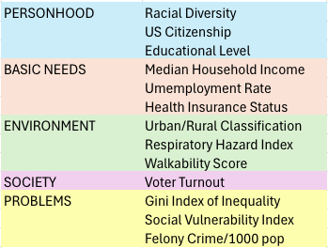
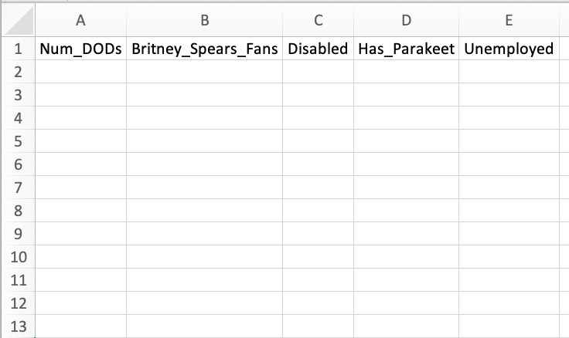


DATA PROCESSING
Remove unwanted and redundant attributes and ANOMALIES
Merge, join, and transform variables into domains, themes, and layers
YEET
BYE
+
=
CDC, USDA EPA CSVs
AHRQ_SDOH CSVs (338 variables)
Turn jurisdictional and county data into census tracts with CROSSWALKS
Consistent punctuation, format, and datatypes
Tract_a
harmonize
Tract_b
categories CaTeGoRiEs
2,487 2487
_UT-500_ UT-500
int64 int64
Tract_c
return f"{x:,}"
Tract_d
JD1
JD2
JD3
JD4
Tract_e
trim
Tract_f
Law Enforcement Jurisdiction
Census Tract
Tract_g
Dtype
Tract_h
TRACTCE GeoJSON (588 records)
Tract_i
Tract_j
Group 4, BMI 6016 Data Wrangling, Spring 2025
Tract_k
Department of Biomedical Informatics
University of Utah School of Medicine
© UNIVERSITY OF UTAH HEALTH
March 14, 2025

Slide 6
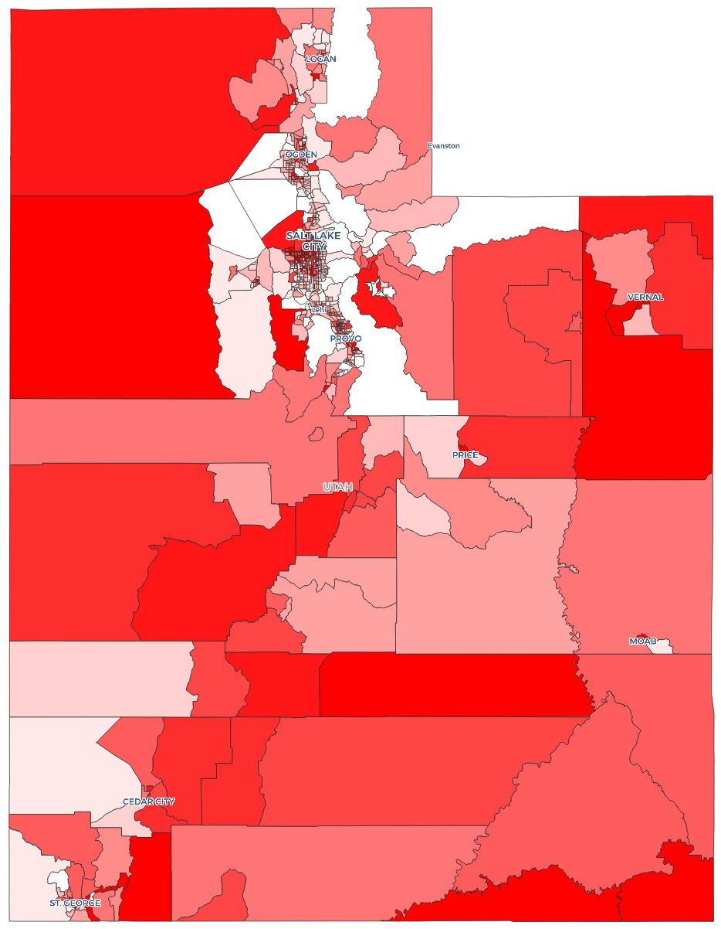
Must-have features
Variables must be granular to the census-tract level
Crosswalks must be available for other geospatial units, like counties
Counts, percentages, means, medians, standard errors all acceptable
A query-ready set of tables in .CSV format
Optional features
GIS data layers mappable to contiguous, Utah census tract map
Formula, lookup tool, or dashboard to retrieve SDOH profile for patient’s address
Group 4, BMI 6016 Data Wrangling, Spring 2025
Department of Biomedical Informatics
University of Utah School of Medicine
© UNIVERSITY OF UTAH HEALTH
March 14, 2025

Slide 7
Schedule/TIMELINE
Feb 16
Feb 16-22
Feb 23-Mar 1
Mar 2-8
Mar 7
Mar 9-15
Mar 16
Mar 16-22
Mar 23-29
Mar 30
Mar 30-Apr 5
Apr 4
Apr 6-12
Apr 13-19
Apr 21
Apr 22
SUBMIT PROJECT PROPOSAL
Identifying key attributes from databases and ensuring census-track mapping
Conceptual model design, variable mapping
Data cleaning/wrangling
MEET W/INSTRUCTORS FOR FEEDBACK #1
Physical database design and setup
INTERMEDIATE PRESENTATION AND PEER FEEDBACK
Model implementation, exploration, and testing
Model validation
PROJECT UPDATE SUBMISSION VIA GITHUB
Documentation of process
MEET W/INSTRUCTORS FOR FEEDBACK #2
Prepare analysis and results
Finalize report/presentation
FINAL PRESENTATION AND PEER FEEDBACK
FINAL PROJECT DUE
Group 4, BMI 6016 Data Wrangling, Spring 2025
Department of Biomedical Informatics
University of Utah School of Medicine
© UNIVERSITY OF UTAH HEALTH
March 14, 2025

Slide 8
IMPLEMENTATION EVALUATION
No big deal
Undecided
Decided
A big deal
Group 4, BMI 6016 Data Wrangling, Spring 2025
Department of Biomedical Informatics
University of Utah School of Medicine
© UNIVERSITY OF UTAH HEALTH
March 14, 2025

Slide 9
references
Social Determinants of Health (SDOH) Database (https://www.ahrq.gov/sdoh/data-analytics/sdoh-data.html
Behavioral Risk Factor Surveillance System (https://www.cms.gov/About-CMS/Agency-Information/OMH/resource-center/hcps-and-researchers/data-tools/sgm-clearinghouse/brfss
NaNDA (National Neighborhood Data Archive) (https://nanda.isr.umich.edu
Braveman, P., Egerter, S., & Williams, D. R. (2011). The social determinants of health: coming of age. Annu Rev Public Health, 32, 381-398. (https://doi.org/10.1146/ annurev-publhealth-031210-101218
Braveman, P., & Gottlieb, L. (2014). The social determinants of health: it's time to consider the causes of the causes. Public Health Rep, 129 Suppl 2(Suppl 2), 19-31. https://doi.org/10.1177/00333549141291S206
Canaday, F. T., Georas, S. N., & Croft, D. P. (2024). Examining the impact of air pollution, climate change, and social determinants of health on asthma and environmental justice. Curr Opin Pulm Med, 30(3), 276-280. (https://doi.org/10.1097/MCP.0000000000001065
Cantor, M. N., Chandras, R., & Pulgarin, C. (2018). FACETS: using open data to measure community social determinants of health. J Am Med Inform Assoc, 25(4), 419-422. (https://doi.org/10.1093/jamia/ocx117
Cook, Q., Argenio, K., & Lovinsky-Desir, S. (2021). The impact of environmental injustice and social determinants of health on the role of air pollution in asthma and allergic disease in the United States. J Allergy Clin Immunol, 148(5), 1089-1101 e1085. (https://doi.org/10.1016/j.jaci.2021.09.018
Gao, C., Sanchez, K. M., & Lovinsky-Desir, S. (2023). Structural and Social Determinants of Inequitable Environmental Exposures in the United States. Clin Chest Med, 44(3), 451-467. (https://doi.org/10.1016/j.ccm.2023.03.002
Marmot, M. (2005). Social determinants of health inequalities. Lancet, 365(9464), 1099-1104. (https://doi.org/10.1016/S0140-6736(05)71146-6
Marmot, M., Allen, J., Bell, R., Bloomer, E., Goldblatt, P., Consortium for the European Review of Social Determinants of, H., & the Health, D. (2012). WHO European review of social determinants of health and the health divide. Lancet, 380(9846), 1011-1029. (https://doi.org/10.1016/S0140-6736(12)61228-8
Group 4, BMI 6016 Data Wrangling, Spring 2025
Department of Biomedical Informatics
University of Utah School of Medicine
© UNIVERSITY OF UTAH HEALTH
March 14, 2025

Slide 10
References, continued
Marmot, M., Friel, S., Bell, R., Houweling, T. A., Taylor, S., & Commission on Social Determinants of, H. (2008). Closing the gap in a generation: health equity through action on the social determinants of health. Lancet, 372(9650), 1661-1669. https://doi.org/10.1016/S0140-6736(08)61690-6
McRoy, L., Rust, G., & Xu, J. (2017). Factors Associated with Asthma ED Visit Rates among Medicaid-enrolled Children: A Structural Equation Modeling Approach. AIMS Med Sci, 4(1), 71-82. https://doi.org/10.3934/medsci.2017.1.71
Office of Disease Prevention and Health Promotion. (2024, Jan 1). Social Determinants of Health Literature Summaries. US Department of Health and Human Services. Retrieved February 16 from https://odphp.health.gov/healthypeople/priority-areas/social-determinants-health/literature-summaries#block-sdohinfographics
The World Health Organization (WHO). (2003). Social Determinants of Health: The Solid Facts, 2nd edition. Retrieved from https://iris.who.int/handle/10665/326568
Zhu, G., Wen, Y., Cao, K., He, S., & Wang, T. (2024). A review of common statistical methods for dealing with multiple pollutant mixtures and multiple exposures. Front Public Health, 12, 1377685. https://doi.org/10.3389/fpubh.2024.1377685
Group 4, BMI 6016 Data Wrangling, Spring 2025
Department of Biomedical Informatics
University of Utah School of Medicine
© UNIVERSITY OF UTAH HEALTH
March 14, 2025

